Slide 1
Unit-1
Introduction to Learning

Slide 2
Contents
Introduction to Learning
Types of Learning

Slide 3
Learning
Meaning of learning in context of Machine Learning.
Learning is acquiring skills or Knowledge from experience.
Any computer program that improves its performance at some task through experience is known as Learning.
Well Defined Definition:
“A computer program is said to learn from experience E with respect to some class of task T and performance P, if its performance at tasks T, as measured by P, improves with experience E.”

Slide 4
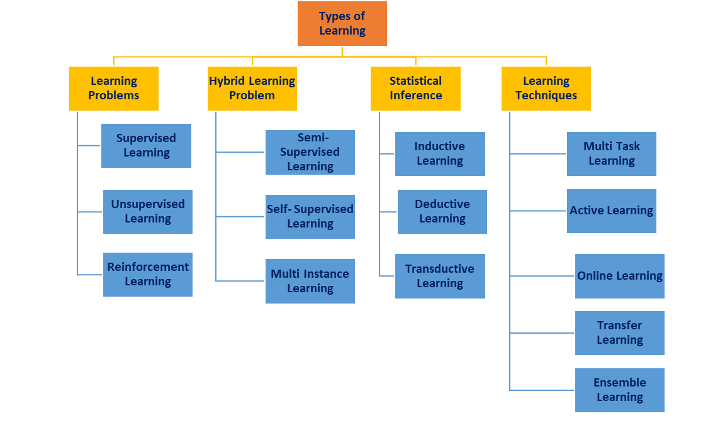
Types of Learning

Slide 5
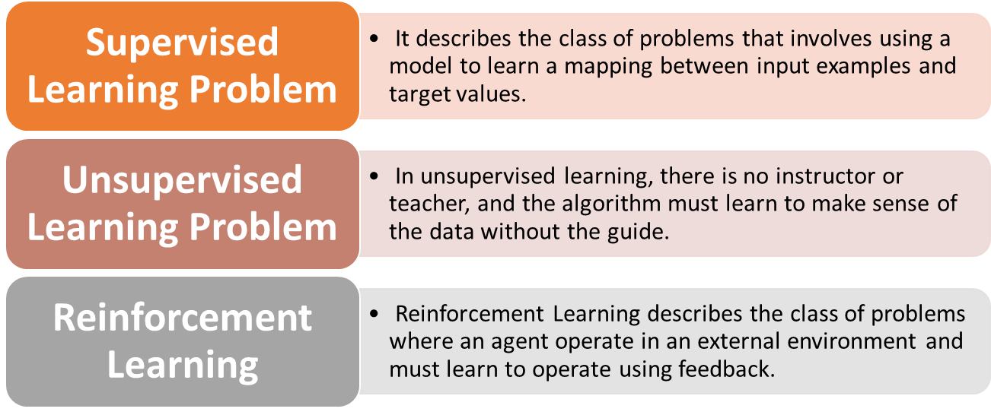
Learning Problems

Slide 6
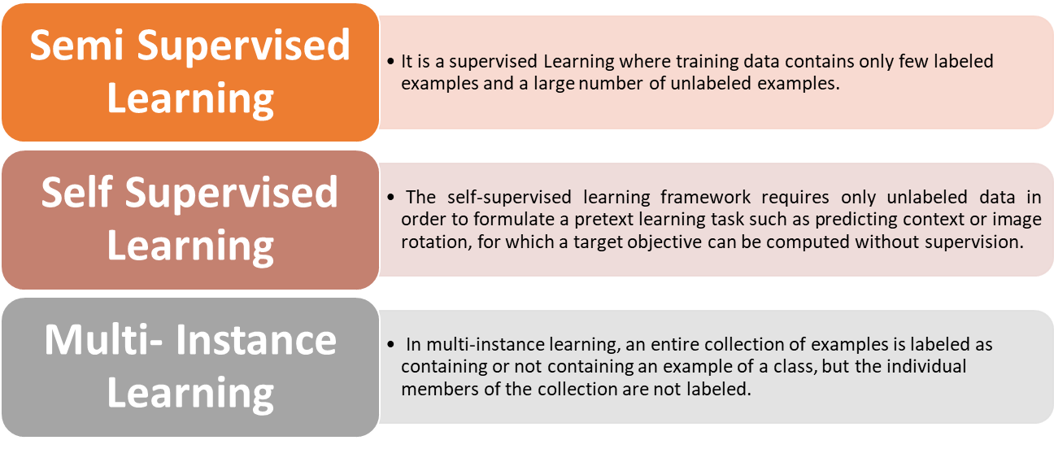
Hybrid Learning Problems

Slide 7
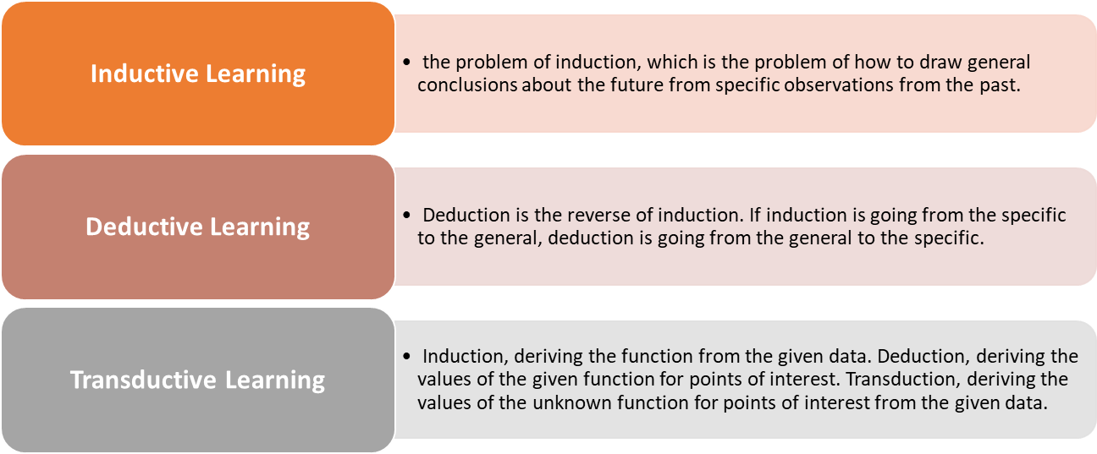
Statistical Inference

Slide 8
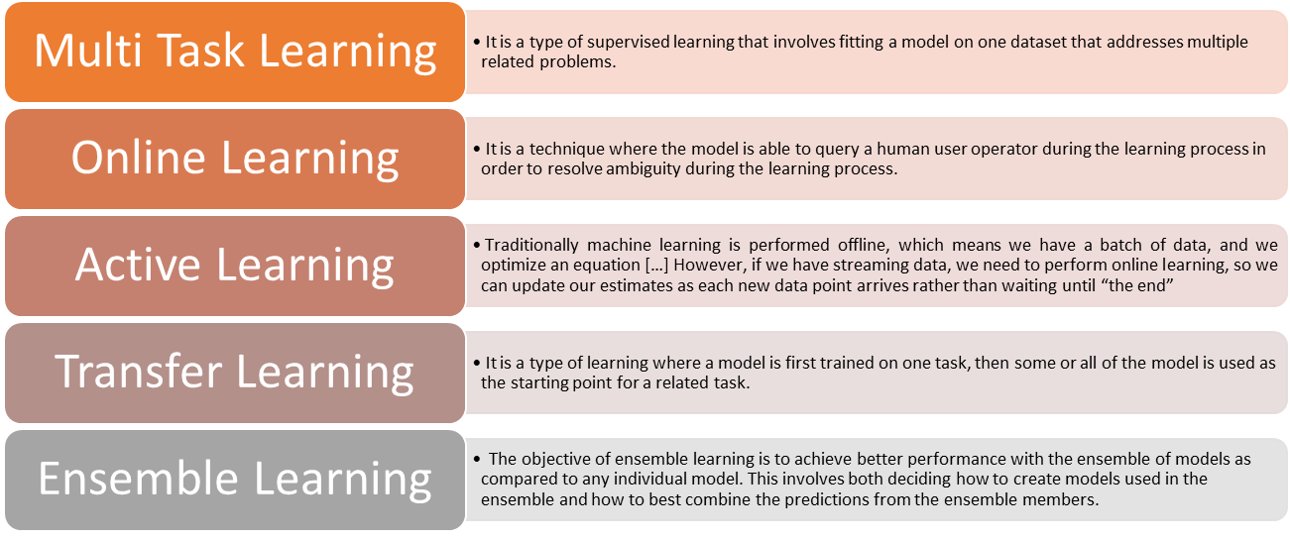
Learning Techniques

Slide 9
Thank
You

